Slide 1
Enhancing Data Analysis: Leveraging SQL Server's Extensibility Framework with Power BI Luca Zavarella

Slide 2


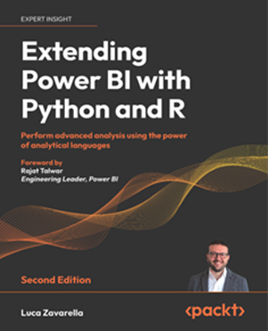
Luca Zavarella
Working in Business Intelligence with SQL Server since 2007
Microsoft MVP for Artificial Intelligence & Data Platform
Microsoft Certified: Azure Data Scientist Associate
Author of “Extending Power BI with Python and R, 2° Ed.” by Packt
Head of Data & AI @
Email: luca.zavarella@icubed.it
Twitter: @lucazav
LinkedIn: https://it.linkedin.com/in/lucazavarella
Blog: https://lucazavarella.medium.com

Slide 4
Agenda
AI in Power BI with Premium Fabric or Embedded Capacities
Configuring SQL Server ML Services
A closer look at sp_execute_external_script
Implementing the Predictive Backend
Let’s Use SQL Server External Languages with Power BI
Let’s Put it All Into Practice in Power BI

Slide 5
AI in Power BI with Premium Fabric or Embedded Capacities

Slide 6
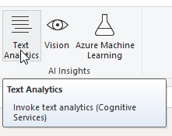
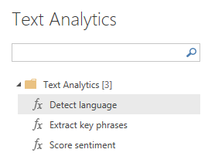
AI Insights Integration
Functions
Language detection: For each text field, returns the language name and ISO identifier (120 languages)
Extract Key Phrases: For each text field, returns a list of key phrases
Score Sentiment: Returns a sentiment score for each document, ranging from 0 (negative) to 1 (positive)
Tag Images: Returns tags based on more than 2,000 recognizable objects, living beings, scenery, and actions.
Access
Self-Service Data Prep for dataflows
Power Query online in the Power BI service
Functions accessed from the ribbon in Power Query Editor or by invoking the M function directly
Support
Power BI
P1 and above capacities
Embedded: EM2, A2
Fabric capacities: F16 and above

Slide 7
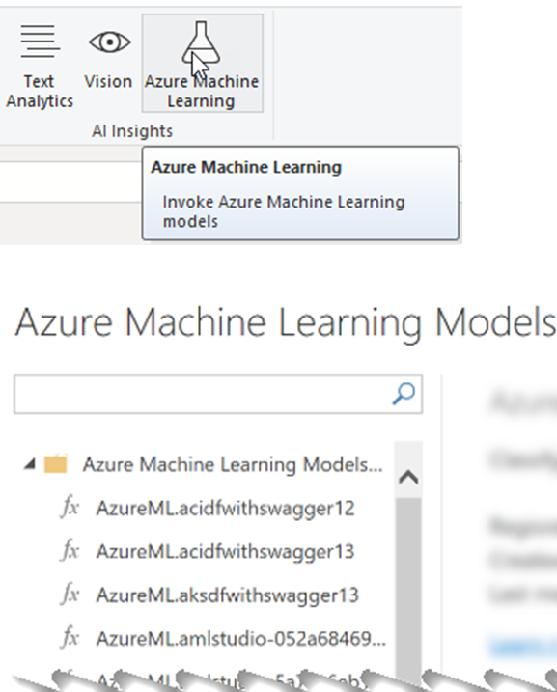
Azure ML Models Integration
Functions
Any type of machine learning model provided by data scientists in the Azure ML workspace
Deployed API shaped accordingly to be consumed by Power BI
Access
Self-Service Data Prep for dataflows
Power Query online in the Power BI service
Functions accessed from the ribbon in Power Query Editor or by invoking the M function directly
Support
Power BI
P1 and above capacities
Embedded: EM2, A2
Fabric capacities: F16 and above

Slide 8
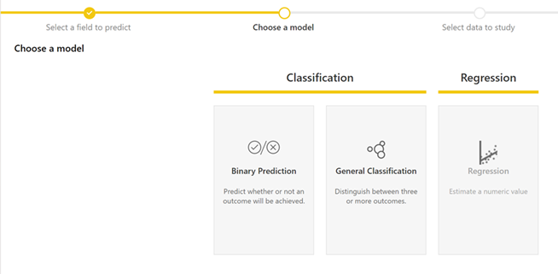
AutoML Integration
Functions
Binary classification
Multi-label classification
Regression
No time-series forecasting!
Access
Available for Dataflows
Premium and embedded capacities
No need of Azure ML Workspace
Support
Power BI
P1 and above capacities or PPU license
Embedded
Fabric capacities: F16 and above

Slide 9

This AI Stuff is Cool, but…

Slide 10
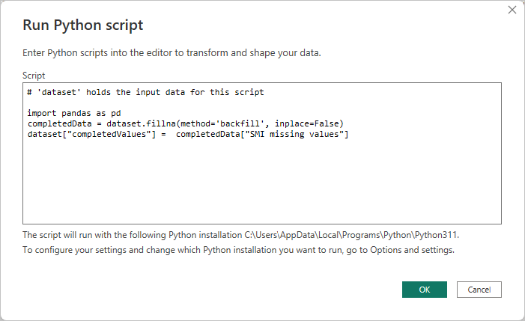
Power BI Python & R Out-Of-The-Box
Functions
Custom code!
Data transformation in Power Query
Custom Python/R Visuals
Access
Power BI Desktop
Support
Starting from Power BI Pro
Cons
Data Gateway Personal Mode (!!)
Pre-installed packages on Power BI Service
Public privacy levels

Slide 11

Perform Advanced Analytics with a Pro License on SQL Server
Use SQL Server!!
Here what you need
“Tweak” SQL Server a little
Learn a trick to call SQL Server procedures from Power BI
A trained ML model to score predictions (for this demo)
Understand a little of Python

Slide 12
Configuring SQL Server ML Services

Slide 13
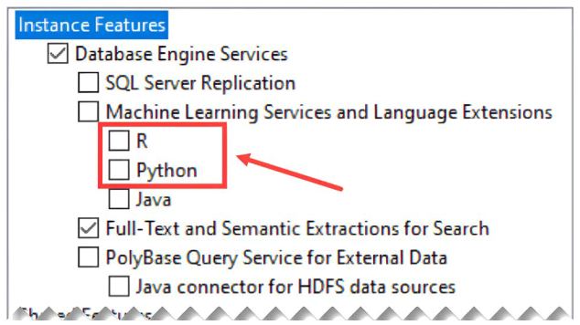
Hidden Gems in SQL Server
SQL Server communicates with external engines through the Launchpad service thanks to the Extensibility Framework
R and Python installed from the Setup are proprietary components
Using these components the latest versions you can have in SQL Server 2019 are Python 3.7.1 and R 3.5.2
With SQL Server 2019 CU3 the External Host process (ExtHost.exe) has been introduced in the Extensibility Framework
Thanks to the External Host, you can add any external compiled language (e.g. Java, C#) using the Extensibility Framework API
Microsoft open sourced the Language Extensions, including files also for R and Python (newer versions)
Starting with SQL Server 2022, you will no longer be able to install the proprietary components for
Python and R from the setup wizard; you will need to manually install the engines and manually
connect them to SQL Server

Slide 14


Only Available in SQL Server on-prem?
Machine Learning Services are also available in Azure SQL Managed Instance
a PaaS offering with near-perfect compatibility with the latest SQL Server database engine in Enterprise Edition
Not in Azure SQL Database
Not in SQL Database in Fabric

Slide 15
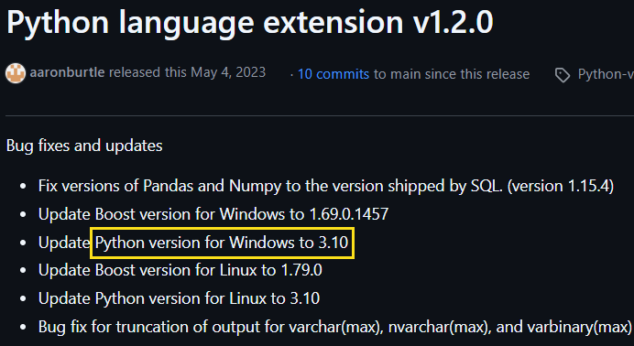
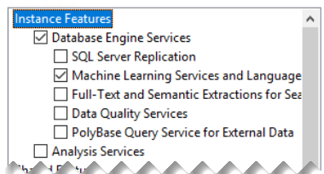
Installing Python Custom Runtimes for SQL Server 1/2
You need to have at least SQL Server 2019 with at least CU3 installed
Install only the Machine Learning Services and Language Extensions feature from the Setup
To choose a Python (or R) version to install, check which one is supported by the latest Language Extension releases (https://github.com/microsoft/sql-server-language-extensions/releases)

Slide 16
Installing Python Custom Runtimes for SQL Server 2/2
The latest Python 3.10 release is 3.10.15 (https://www.python.org/downloads/)
Unfortunately, only release 3.10.11 provides Windows installers (https://www.python.org/downloads/release/python-31011/)
During the Python installation, be sure to:
Check “Add python.exe to PATH”
Check “For all users (requires admin privileges)”
Uncheck “Download debugging symbols”
Uncheck “Download debug binaries”

Slide 17
Configuring the SQL Server Language Extensions 2/3
Steps to follow
The Language Extension file you need to download from GitHub is python-lang-extension-windows-release.zip
Make sure you save these files in a folder that SQL Server has access to (e.g. C:\LanguageExtensions)
Register the external Language Extension in your selected database from the specified file paths giving it a specific name (e.g. py310, case sensitive):
USE <your-database> GO
CREATE EXTERNAL LANGUAGE [py310]
FROM (CONTENT = N'C:\LanguageExtensions\python-lang-extension-windows-release.zip',
FILE_NAME = 'pythonextension.dll',
ENVIRONMENT_VARIABLES = N'{"PYTHONHOME": "C:\\Program Files\\Python310"}');
GO
The CREATE EXTERNAL LANGUAGE statement creates an external language specifically in the database on which the query is executed. If you need the ability to run Python and R scripts on a different database, you must run CREATE EXTERNAL LANGUAGE queries on that database too

Slide 18
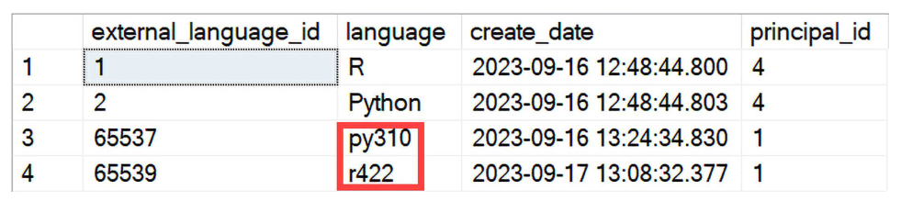
Configuring the SQL Server Language Extensions 3/3
Steps to follow
You need to enable external scripts in your instance with this script:
sp_configure 'external scripts enabled', 1;
RECONFIGURE WITH OVERRIDE;
Check if the external language has been created correctly using the sys.external_languages catalog view:
SELECT * FROM sys.external_languages;

Slide 19
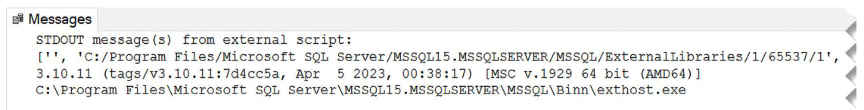
Your First Python Script from SQL Server
The tool in T-SQL to execute a script is the system-stored procedure sp_execute_external_script
Essential parameters
External language identifier (e.g. py310)
String of the script to execute
EXEC sp_execute_external_script @language = N'py310',
@script=N'
import sys
print(sys.path)
print(sys.version)
print(sys.executable)';

Slide 20
A closer look at sp_execute_external_script

Slide 21
DEMO 1
Understanding Input and Output parameters of sp_execute_external_script

Slide 22
Implementing the predictive backend

Slide 23
Using FLAML AutoML Model in SQL Server
Simplified ML Model Creation by Analysts (out-of-scope)
FLAML AutoML makes it easy to create machine learning models
Models can be serialized and saved in pickle format for reuse
Set Up Model for SQL Server
Place the pickle model in a folder accessible by SQL Server
Save the model in binary format within a database table
Prediction Integration
Use the model for predictions
Return predicted labels and probabilities based on input parameters
All into a stored procedure

Slide 24
DEMO 2
Implementing the predictive backend

Slide 25
Let’s Use SQL Server External Languages with Power BI

Slide 26
Why the Need of External Languages with Power BI
Enterprise Architecture Constraints
Power BI’s Personal Gateway mode for built-in Python and R is unsuitable for enterprise-level, multi-user environments
Privacy and Security Challenges
Public privacy levels in Power BI can expose sensitive data when combining data sources
Processing Large SQL Server Datasets
External languages leverage SQL Server's resources to handle large datasets securely and efficiently
Missing Libraries in Power BI Service
Overcomes the limited library support in Power BI by running scripts directly in SQL Server
Key Benefit
Keeps advanced analytics workflows scalable, secure, and integrated into the main data flow

Slide 27
What We’ll Do in Power BI
Objective
Enable real-time prediction updates in Power BI using the Titanic Survival model without refreshing the dataset
Solution Overview
Use DirectQuery mode to query SQL Server in real-time
SQL Server runs the model scoring script and enriches data dynamically
Key Implementation Steps
Call sp_execute_external_script within a stored procedure
Use stored procedures for data enrichment in Power BI

Slide 28
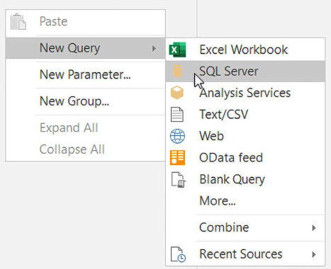
Execute Stored Procedures in DirectQuery
Here what I tried do
Enter an EXEC <my-stored-procedure> … statement in a DirectQuery SQL Server new Query in Power Query
Once entered, all works fine, and you can see the data as output
When you click Close & Apply, you get the mysterious Incorrect syntax near the keyword ‘EXEC’ error!
What happens behind the scene?
I used the SQL Server Profiler and I got this metadata validation query:
select * from (
EXEC <my-stored-procedure> … WITH RESULT SETS ((…))
) SourceQuery where 1 = 2

Slide 29
Converting an EXEC to SELECT ... FROM 1/2
In SQL Server, external data can be retrieved using the OPENROWSET function with OLE DB providers:
SELECT *
FROM OPENROWSET('SQLNCLI', 'server=.;Trusted_Connection=yes;',
'SELECT configuration_id, name FROM sys.configurations’)
The SQLNCLI OLE DB provider for connecting to SQL Server is pre-installed with the SQL Server setup.
The first time you run the above query, you get an error:
Msg 15281, Level 16, State 1
SQL Server blocked access to STATEMENT 'OpenRowset/OpenDatasource' of component 'Ad Hoc Distributed Queries' because this component is turned off as part of the security configuration for this server.

Slide 30
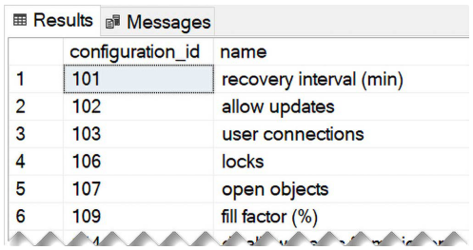
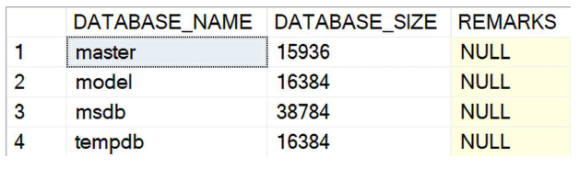
Converting an EXEC to SELECT ... FROM 2/2
Ad Hoc Distributed Queries feature must be enabled:
-- To show advanced options
EXEC sp_configure 'show advanced options', 1;
RECONFIGURE;
-- To enable Ad Hoc Distributed Queries
EXEC sp_configure 'Ad Hoc Distributed Queries', 1;
RECONFIGURE;
Now the query “SELECT … FROM sys.configurations” works fine!
But what if we try to run an EXEC query through the OPENROWSET?
SELECT *
FROM OPENROWSET('SQLNCLI', 'server=.;Trusted_Connection=yes;',
'EXEC [sys].[sp_databases]')
It works too! ☺

Slide 31
Let’s Put it All Into Practice in Power BI

Slide 32
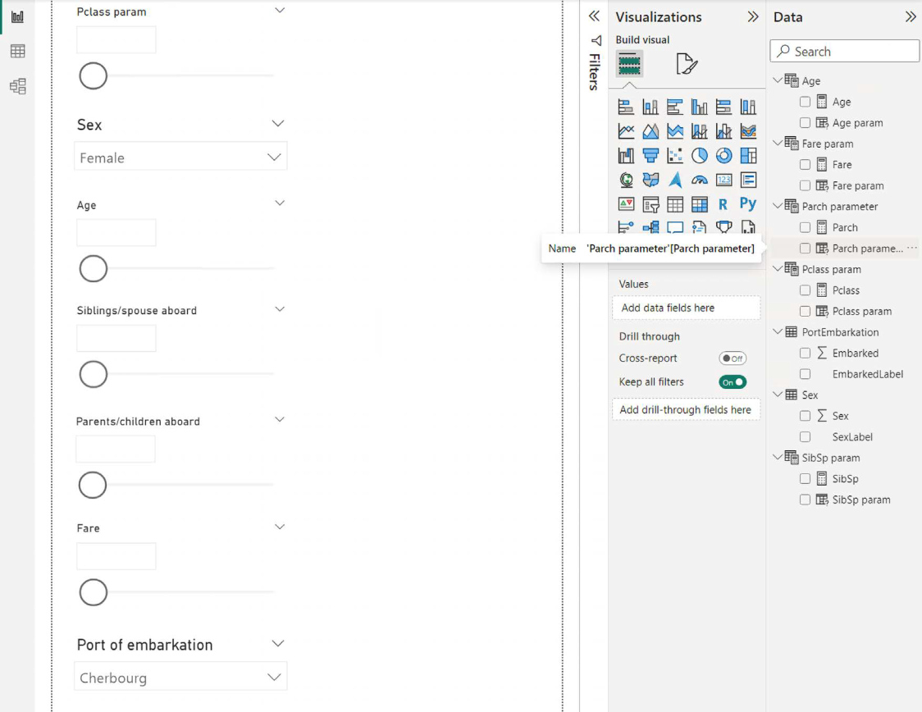
The Report Backbone
Each slider shows data from the respective table
Each slider is related to a ML model parameter
DirectQuery call to the stored procedure is done into Power Query, so you need Parameters to map sliders values to the stored procedure parameters

Slide 33
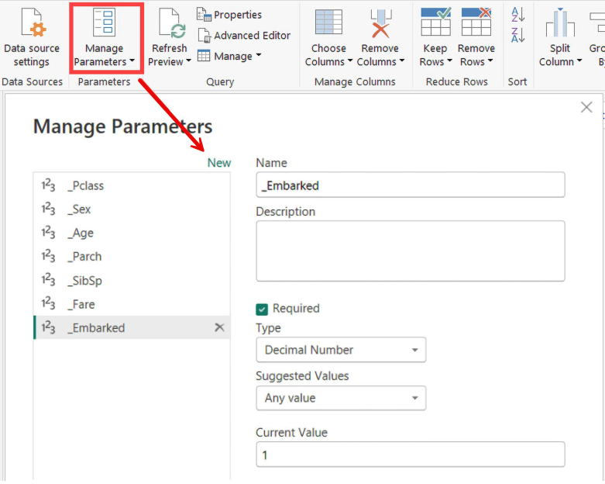
Define Parameters in Power Query
Set the correct data type for each parameter according to the ones expected by the stored procedure
You can leave 1 as Current Value for all of them

Slide 34
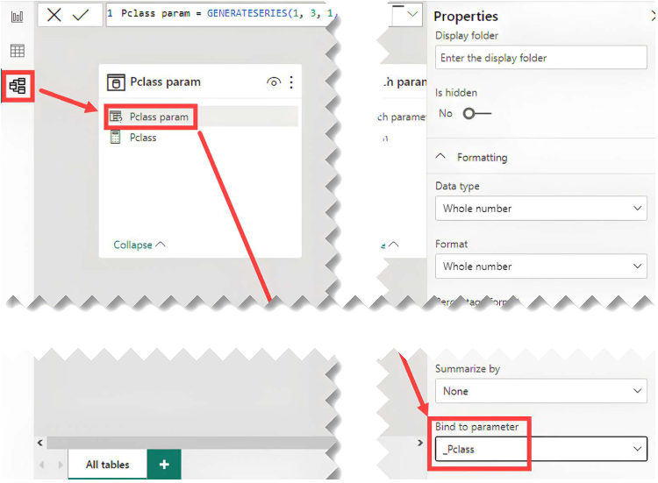
Bind Parameters to Table Fields
Go to Model View and select the numeric field to bind to a parameter
In its Advanced properties set the Parameter name into the Bind to parameter combo box
Select None for Summarize by

Slide 35
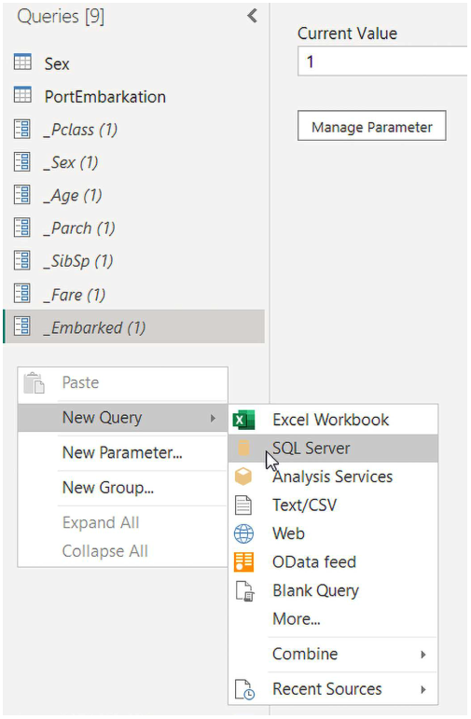
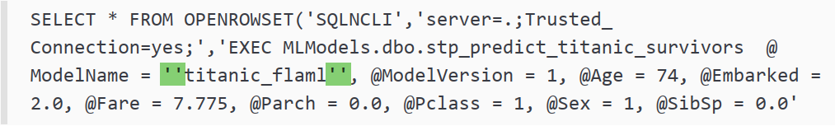
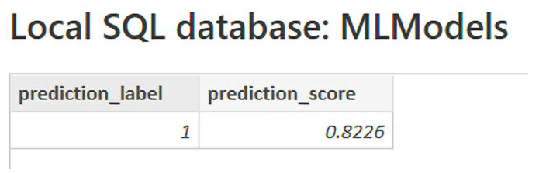
Create the DirectQuery to SQL Server
SQL Statement with the trick and fixed parameters:

Slide 36
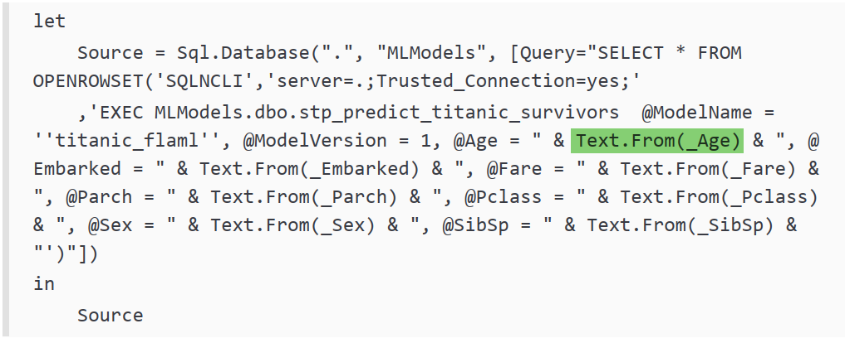
Let’s Use Parameters in SQL Statement
Replace constants with Text.From(…) in the M expression

Slide 37
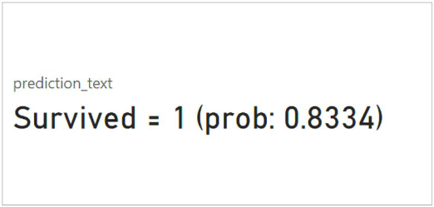
Show the Prediction in a Card Visual
Create a new DAX measure to combine prediction and probabilities…
... and show it in your Card!

Slide 38
DEMO 3
Let’s Play With the Power BI Predictive Report

Slide 39

Learn more about these topics
All steps shown in this session are detailed in my book!
Paperback & Kindle
Amazon.it
Amazon.com
Amazon.<what-you-want>
PDF, EPUB, MOBI (DRM free)
Packtpub.com

Slide 40
References
Install a Python custom runtime for SQL Server 2019 (https://learn.microsoft.com/en-us/sql/machine-learning/install/custom-runtime-python)
Install SQL Server 2022 Machine Learning Services (Python and R) on Windows (https://learn.microsoft.com/en-us/sql/machine-learning/install/sql-machine-learning-services-windows-install-sql-2022)
Fix: Getting R and Python to actually work on SQL Server 2022 (https://blog.greglow.com/2024/03/04/fix-getting-r-and-python-to-actually-work-on-sql-server-2022/)
SQL Server Language Extension Releases (https://github.com/microsoft/sql-server-language-extensions/releases)
SQL Server on Windows: Isolation changes for Machine Learning Services (https://learn.microsoft.com/en-us/sql/machine-learning/install/sql-server-machine-learning-services-2019)
Implied authentication (loopback requests) (https://learn.microsoft.com/en-us/sql/machine-learning/concepts/security?view=sql-server-ver16#implied-authentication-loopback-requests-1)
Manage Python and R workloads with Resource Governor in SQL Server Machine Learning Services (https://learn.microsoft.com/en-us/sql/machine-learning/administration/resource-governor)

Slide 41
THANK YOU!! ☺

